Slide 1
5 KEYS TO SOLVE ANY PROBLEM.
Transforming love community.
Dr. shaheerah

Slide 2
A Course In Miracles teaches us…
There is only one problem:
A belief in separation
There is only one solution:
At-One-Ment

Slide 3
Seems like we have a myriad of different problems…
OUR BIGGEST PROBLEM IS THAT WE BELIEVE WE ARE SEPARATED FROM GOD
Many of us were conditioned to believe in a God in the sky.
WE BELIEVE THAT WE ARE INHERENTLY BAD THUS UNWORTHY
WE BELIEVE WE ARE JUST A BODY WITH A NUMBER OF YEARS TO HANG OUT HERE AND THEN WE DIE.

Slide 4
I was attracted into truth thru Unity because of their 5 basic foundational principles.
1. God is absolute good, everywhere present.
2. Human beings have a spark of divinity within them, The Christ spirit within. Their very essence is of God, and therefore they are also inherently good.
3. Human beings create their experiences by the activity of their thinking. Everything in the manifest realm has its beginning in thought.
4. Prayer is creative thinking that heightens the connection with God‐Mind and therefore brings forth wisdom, healing, prosperity, and everything good.
5. Knowing and understanding the laws of life, also called Truth, are not enough. A person must also live the truth that he or she knows. The 5 Principles Adapted For Children A

Slide 5
Hebrews 11:
Now faith is the substance of things hoped for, the evidence of things not seen.
² For by it the elders obtained a good report.
³ Through faith we understand that the worlds were framed by the word of God, so that things which are seen were not made of things which do appear.

Slide 6
LOVE IS A COMMAND

Slide 7
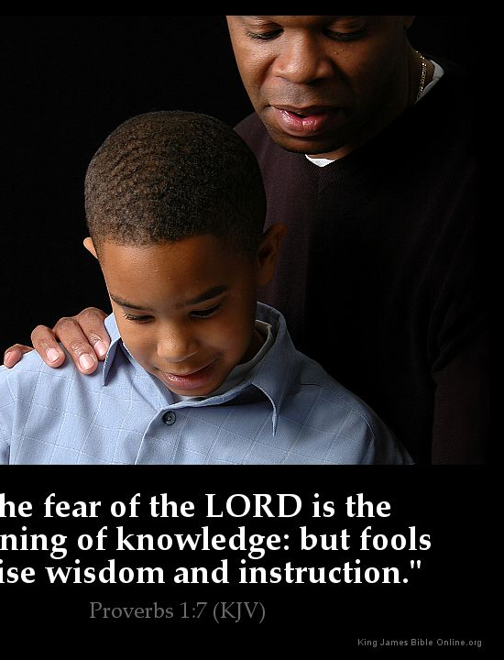
WISDOM

