Slide 1
Soul Level Healing
2022
Rev. Shaheerah
Thank you God for harmony in all of my relationships and divine resources for every need forever.

Slide 2
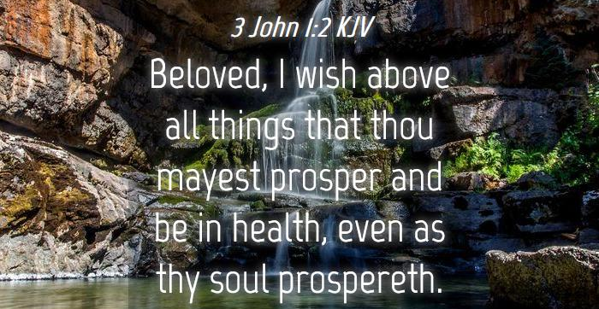

Slide 3
WHAT IS THE SOUL?
The part of us that existed before our birth and the part of us that exists after death.
The gateway between God and this physical realm.
The non-physical place where all major life events are stored.

Slide 4

Spirit made the Soul and the Soul constructed the Body.

Slide 5

The Soul and Relationships

Slide 6
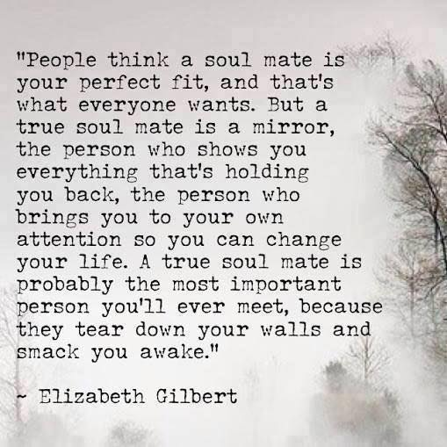

Slide 7
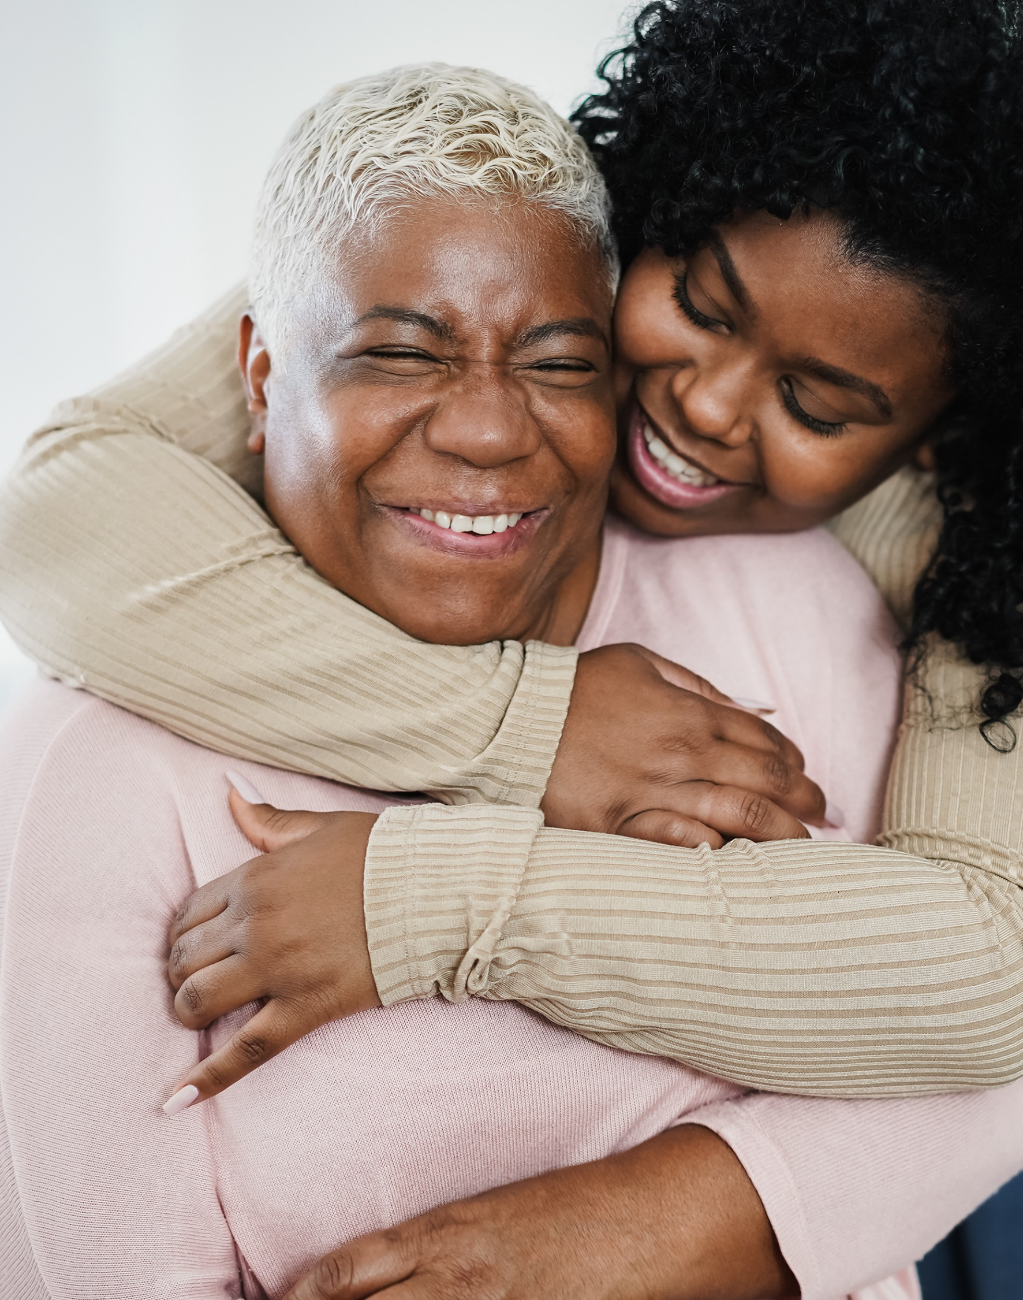
In order to experience loving relationships across the board, give up the need to be right!

Slide 8
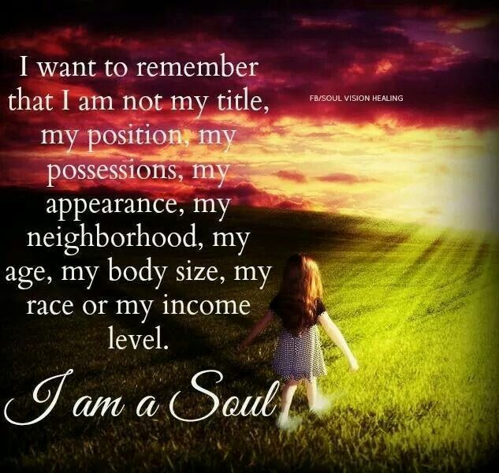

Slide 9
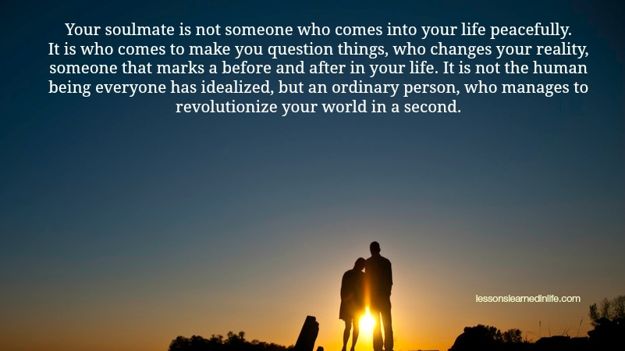

Slide 10
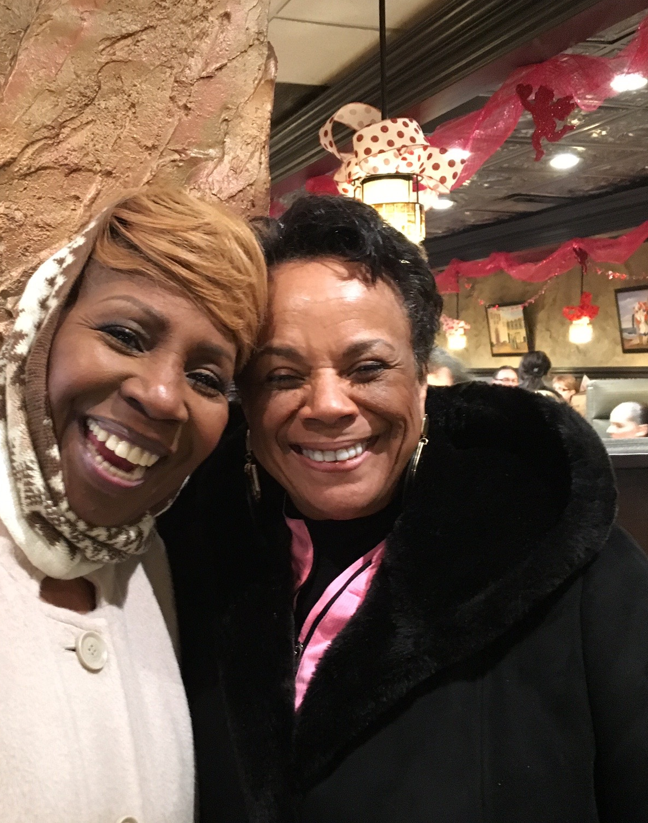
Soulmates can be friends. They do not have to always be a “romantic” partnership.

Slide 11

Practice soul-level listening.
Listen to your longings.

Slide 12
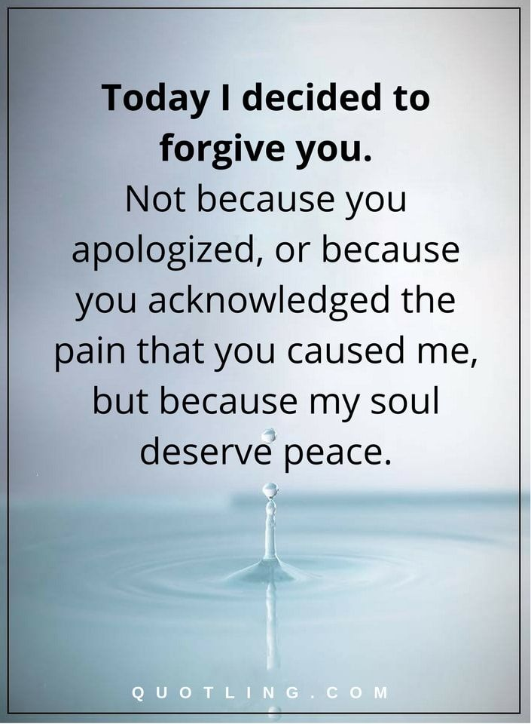
Soul Prosperity requires forgiveness. OFTEN.

Slide 13
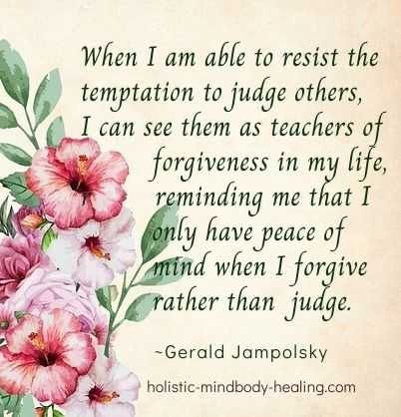
As you see your sister or brother…speaks more about you than them.

Slide 14
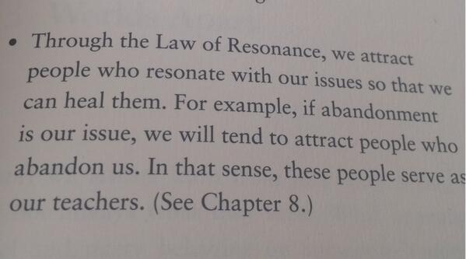
Rev. Ike said, “You only meet you!”

Slide 15
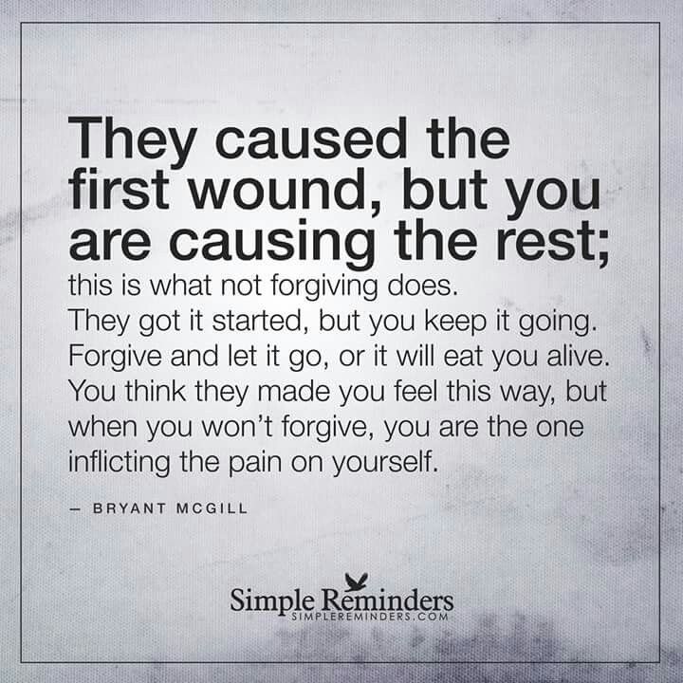
On an “energetic level” we are a vibrational matches to the people we connect with.. No one meets anyone by accident.

Slide 16


Slide 17
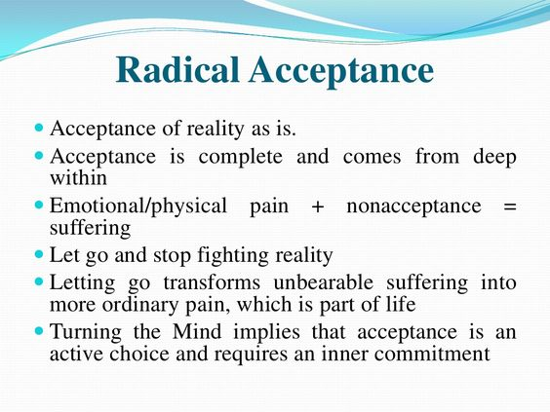
Radical Acceptance is key to peace of mind thus “soul-level” healing.

Slide 18
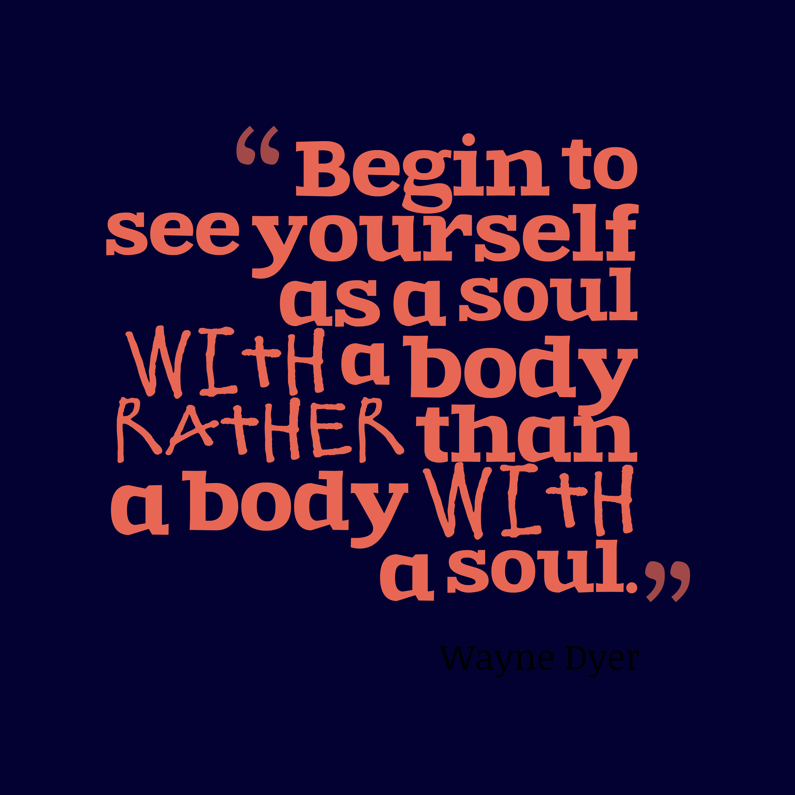
Soul level healing takes commitment and intention.

Slide 19
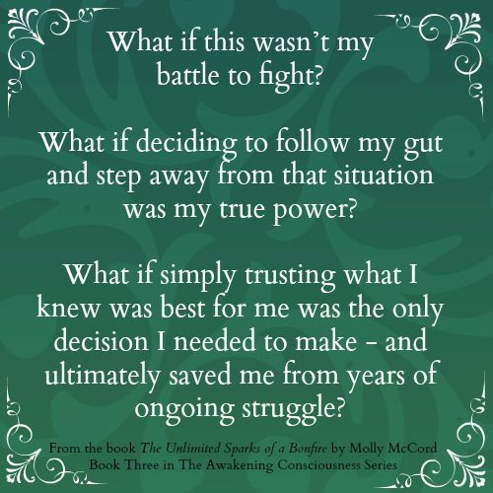
If you are arguing or debating, you have a need to be right. Let it all go.

Slide 20
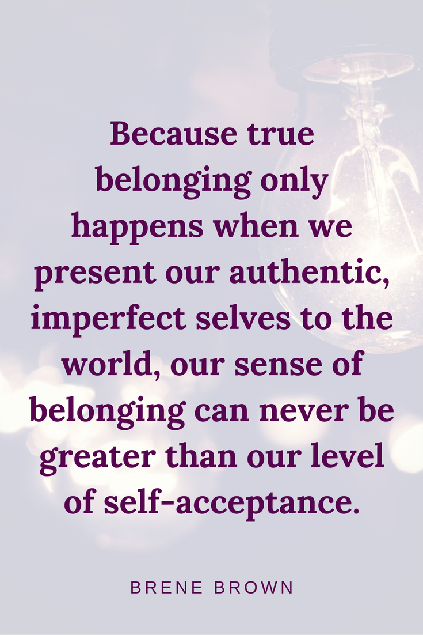
Practice not judging yourself. Judging yourself or others creates a block to your ability to manifest goodness.

Slide 21
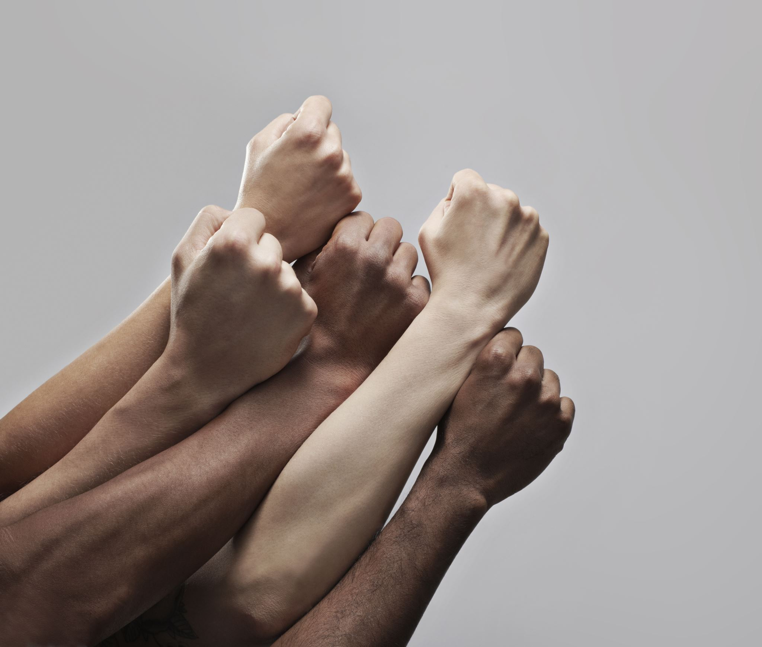
Embrace your pain. Embrace your sorrow. These are acts of love.

Slide 22
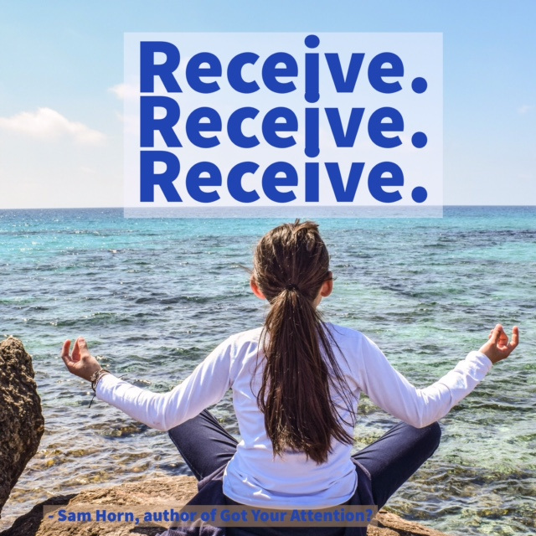
When you know that you have done your forgiveness work…forgiving you and all others…open your mind to receive.

Slide 23
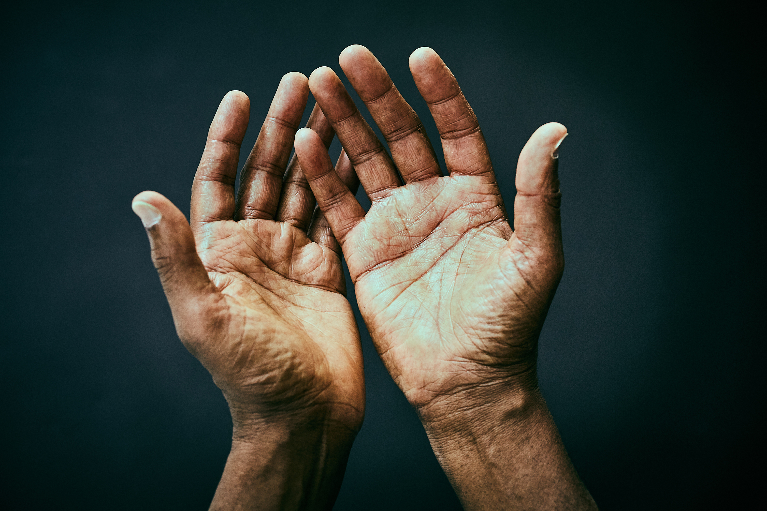
Let’s pray together.
What are you believing this morning?

Slide 24

Thank you Beloved Most High God for healing our souls. Thank you for teaching us that we are deeply loved.

Slide 25
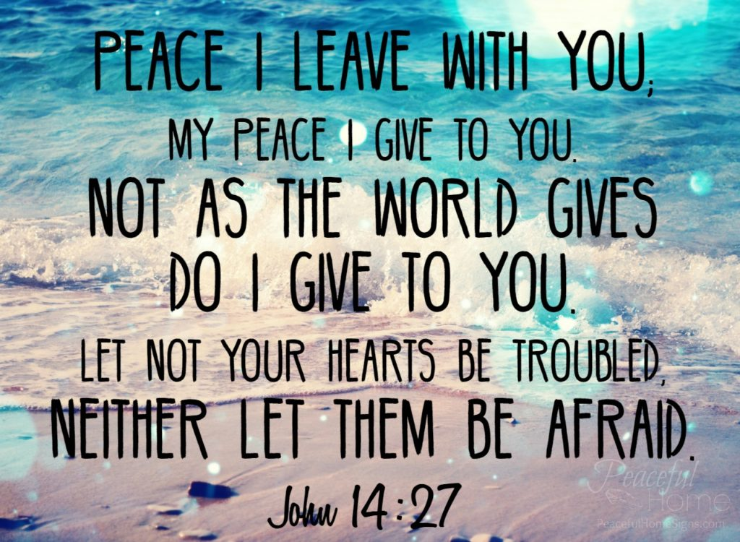
Lord, I really thank you for the peace that YOU give…like no other.

Slide 26
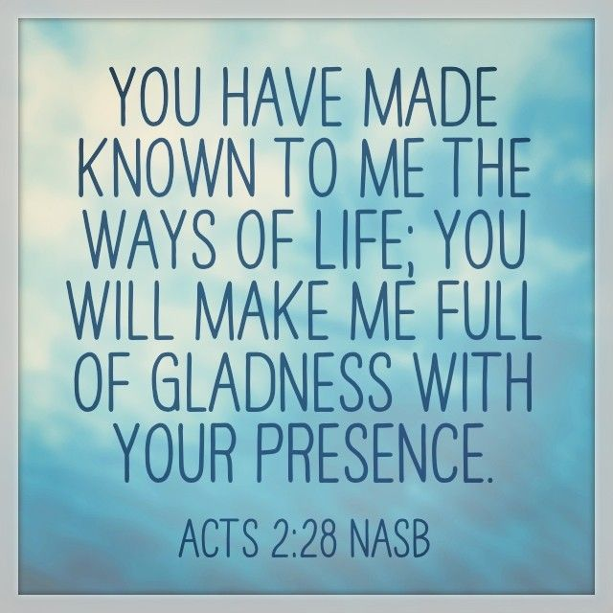
Thank you for your present Presence that holds everything I could ever need forever.

Slide 27
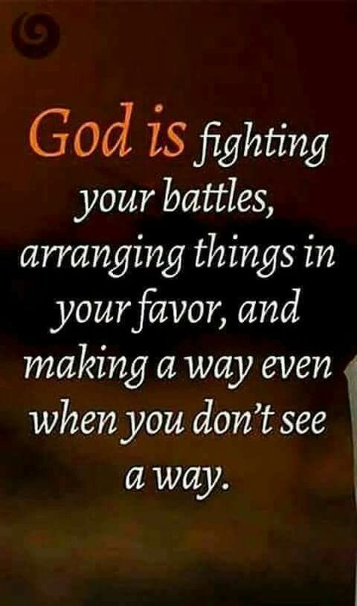
You don’t have to fight ANY battles. God is your defense and your defender!

Slide 28

God is perfecting all that concerns you re: your family. We bless our families.

Slide 29
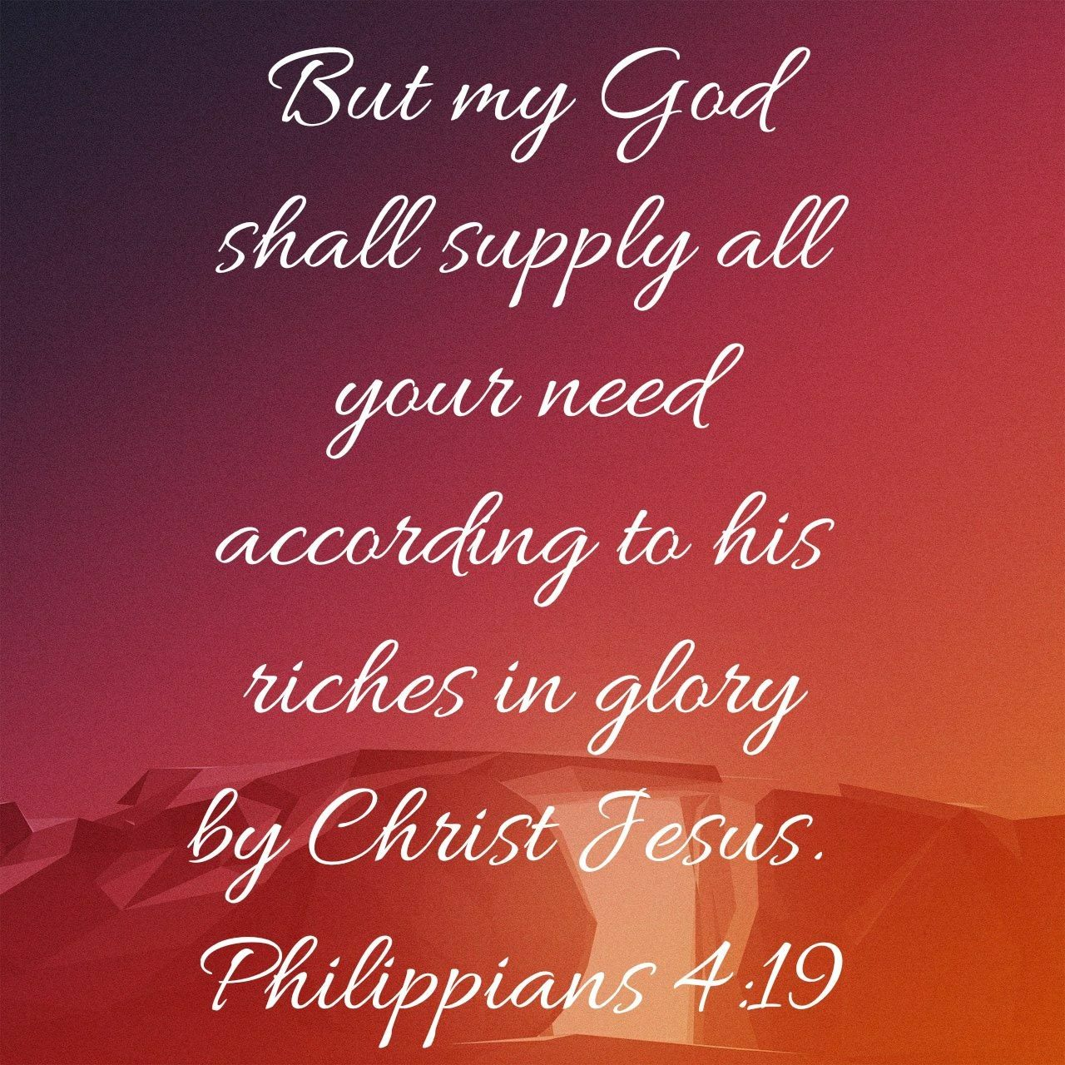
Before you even know you have a problem, God already has the answer.

Slide 30
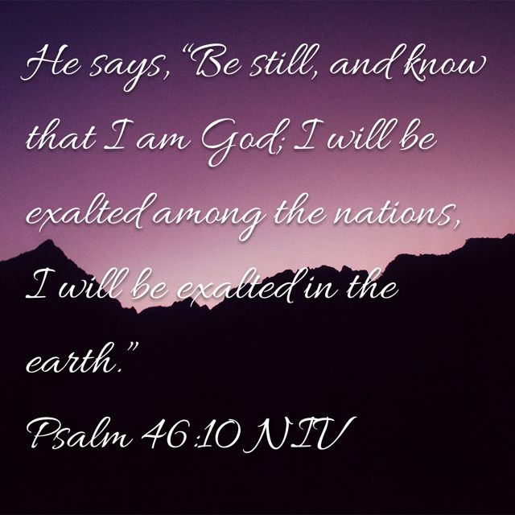

Slide 31
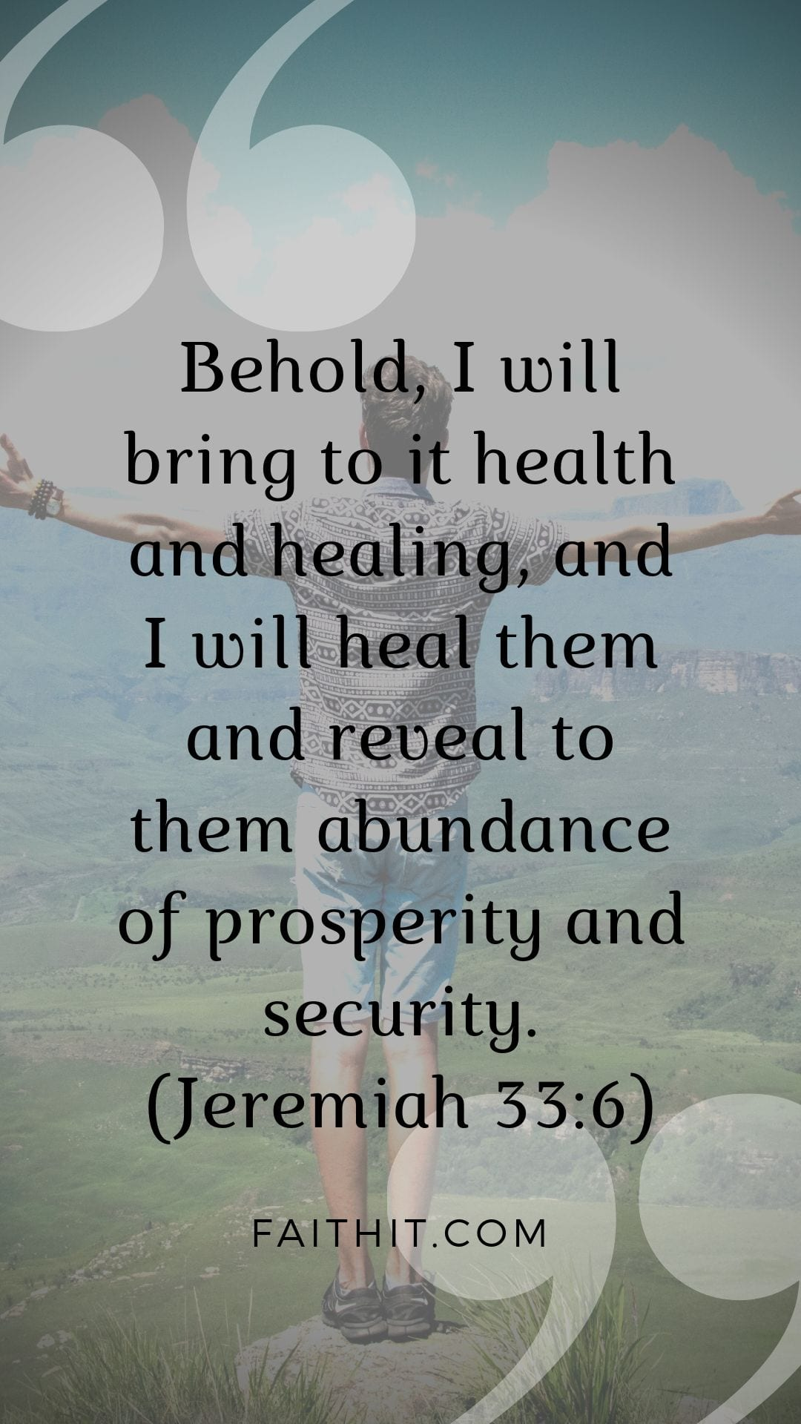

Slide 32
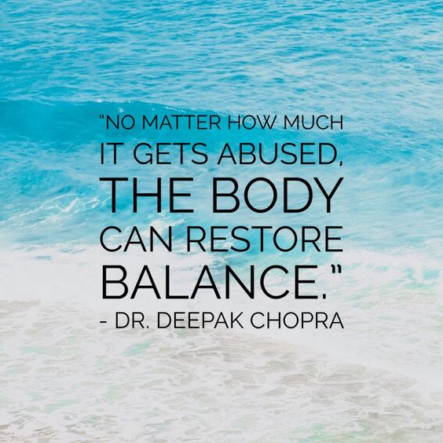
Thank you for restoring my soul. As I choose peace…my body responds with radiant health.

Slide 33
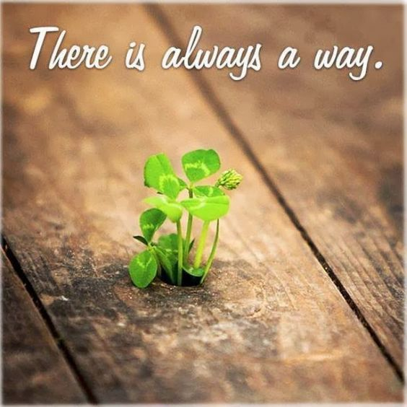
Thank you for increasing my capacity to receive.

Slide 34
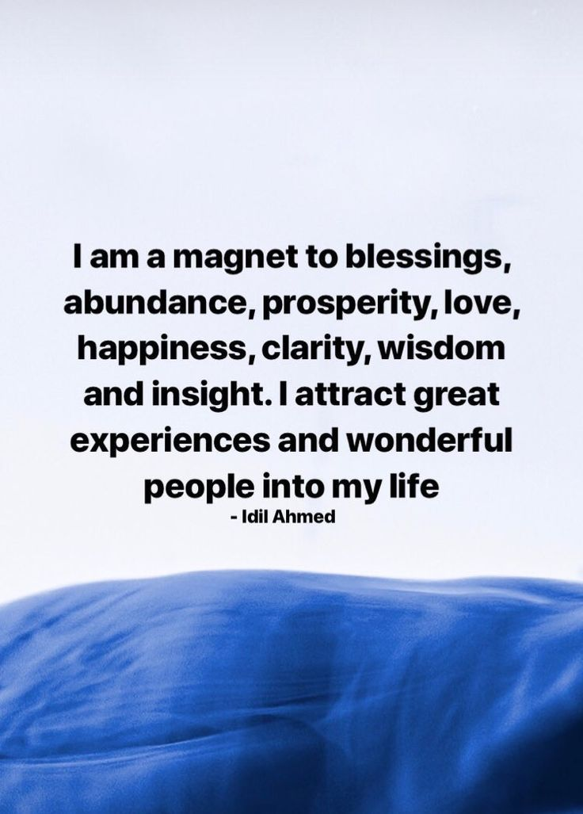

Slide 35

Thank you God for a record harvest this year.

Slide 36
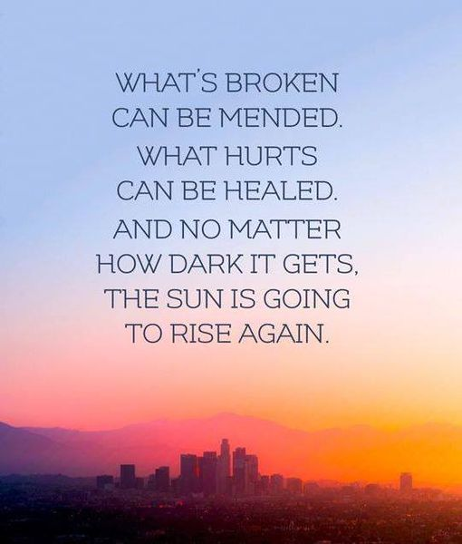
Thank you healing every soul that’s grieving or suffering in any way.

Slide 37


