Slide 1
DOUBLE FOR YOUR TROUBLE
Rev. Dr. Shaheerah Stephens

Slide 2
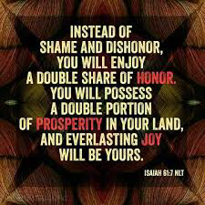

Slide 3
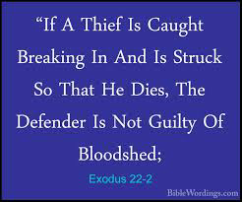

Slide 7
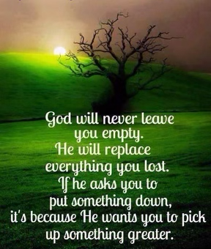

Slide 11
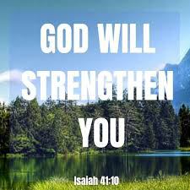

Slide 16
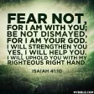

Slide 17
