Slide 1
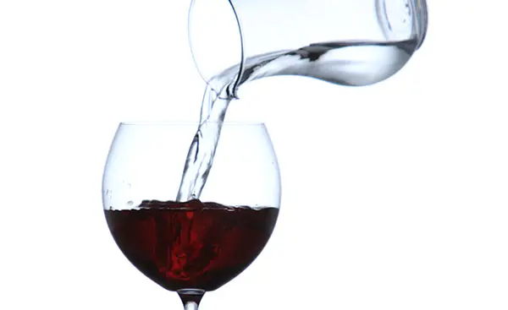
The First Miracles club
Sip & Study

Slide 2
Acim introduction....
This is a course in miracles. It is a required course. Only the time you take is voluntary. Free will does not mean that you can establish the curriculum. It means that only you can elect what you want to take at a given time. The course does not aim at teaching the meaning of love, for that is beyond what can be taught, It does aim, however, at removing the blocks to the awareness of love’s presence, which is your natural inheritance. The opposite of love is fear, but what is all-encompassing can have no opposite. This course can therefore be summed up very simply in this way:
Nothing real can be threatened.Nothing unreal exist.Herein lies the peace of God.

Slide 3
The MeaninG of Miracles
A miracle is about your mind - not about the world. The solution ACIM offers is internal, and it involves a correct understanding of who we are and where we are. “The journey to God is merely the reawakening of the knowledge of where you are always, and what you are forever.”

Slide 4
A course in Miracles
50 Principles
Part 2

Slide 5
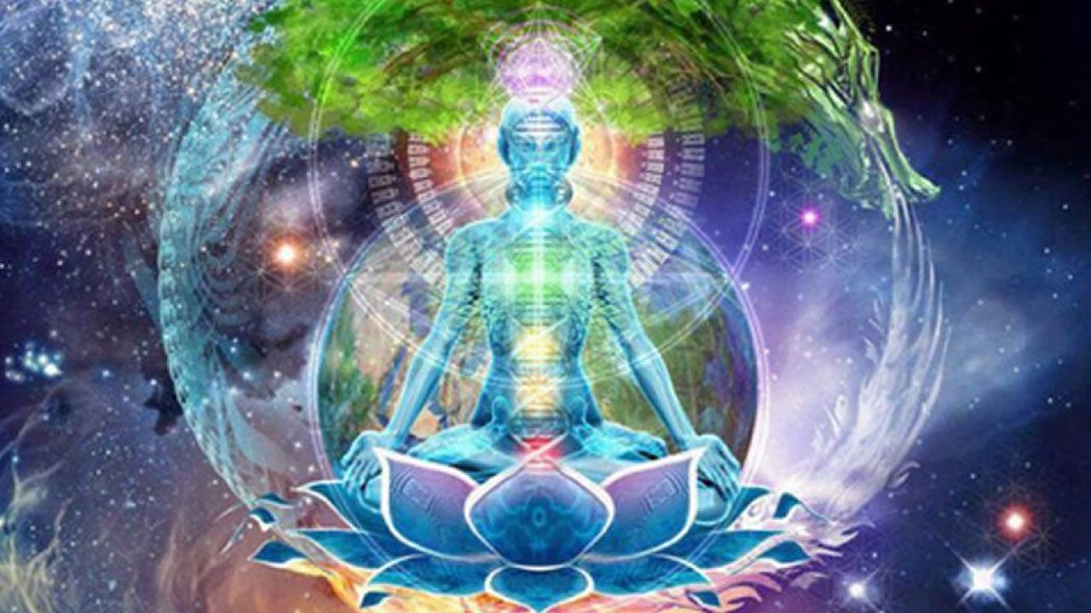
42. A major contribution of miracles is their strength in releasing you from your false sense of isolation, deprivation and lack.

Slide 6
Lesson 257...Let Me Remember what my purpose is
1. If I forget my goal I can be but confused, unsure of what I am, and thus conflicted in my actions. ²No one can serve contradicting goals and serve them well. ³Nor can he function without deep distress and great depression. ⁴Let us therefore be determined to remember what we want today, that we may unify our thoughts and actions meaningfully, and achieve only what God would have us do this day. (ACIM, W-257.1:1)......

Slide 7
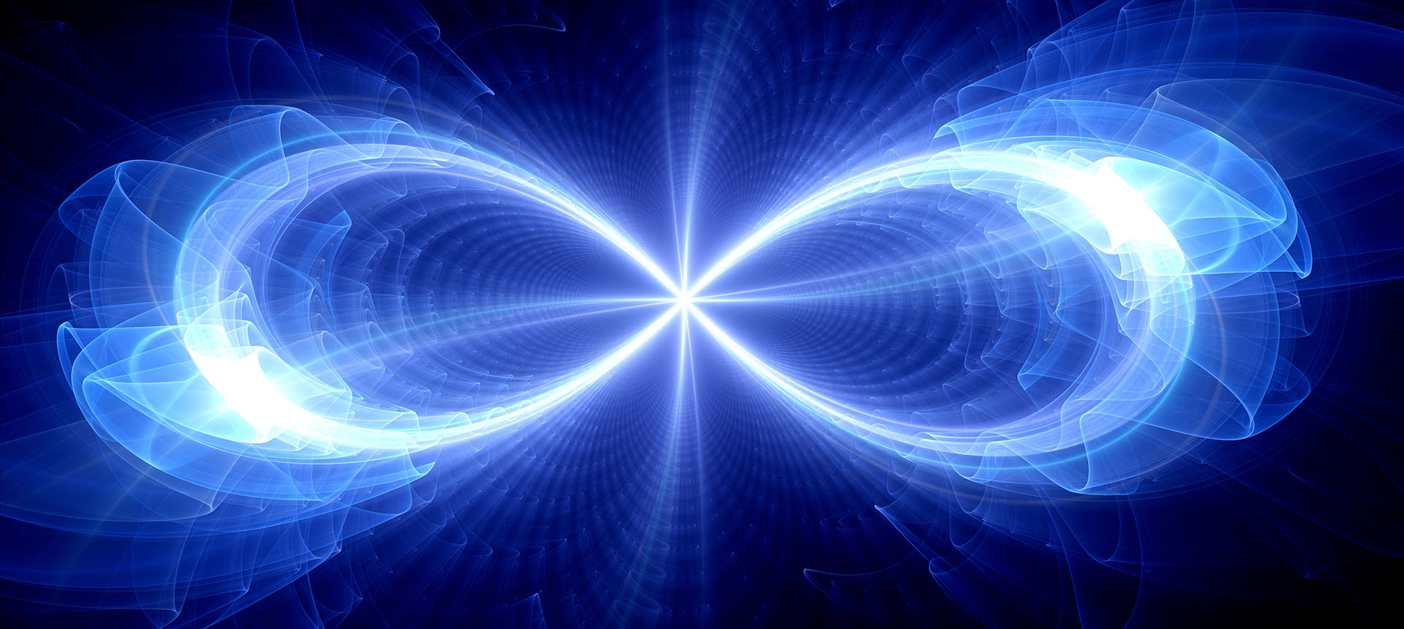
43. Miracles arise from a miraculous state of mind, or a state of miracle-readiness.

Slide 8
Lesson 111...
1. (91) Miracles are seen in light.
²I cannot see in darkness. ³Let the light of holiness and truth light up my mind, and let me see the innocence within.
(ACIM, W-111.1:1)

Slide 9
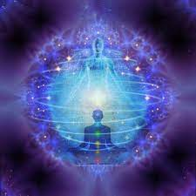
41. Wholeness is the perceptual content of miracles. They thus correct, or atone for, the faulty perception of lack.

Slide 10
Lesson 113...
1. (95) I am one Self, united with my Creator.
²Serenity and perfect peace are mine, because I am one Self, completely whole, at one with all creation and with God.
(ACIM, W-113.1:1).....

Slide 11
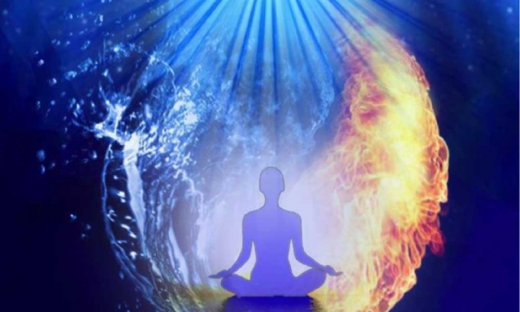
49. The miracle makes no distinction among degrees of misperception. It is a device for perception-correction, effective quite apart from either the degree or the direction of the error. This is its true indiscriminateness.

Slide 12
Lesson 320: My Father Gives all power unto me...
1. The Son of God is limitless. ²There are no limits on his strength, his peace, his joy, nor any attributes his Father gave in his creation. ³What he wills with his Creator and Redeemer must be done. (ACIM, W-320.1:1-3)

Slide 13
Questions & Comments

