Slide 1
Behold the Beam Within!
Transforming Love Community
Facilitator: Rev. Tia Littlejohn
Sunday, July 10, 2022

Slide 2
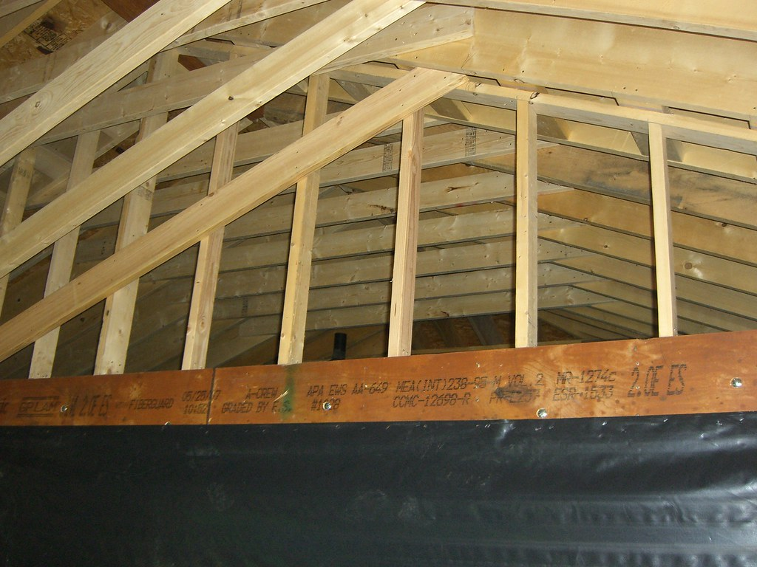
Behold – To see or observe Take in the fullness of the light that you bear.
z

Slide 3
Acknowledging the Internal GPS God's Plan is Sure!

Slide 4
Owning ALL of your Illuminous Projections!
z
Be not conformed
Be transformed
The proof is in LIVING!

Slide 5
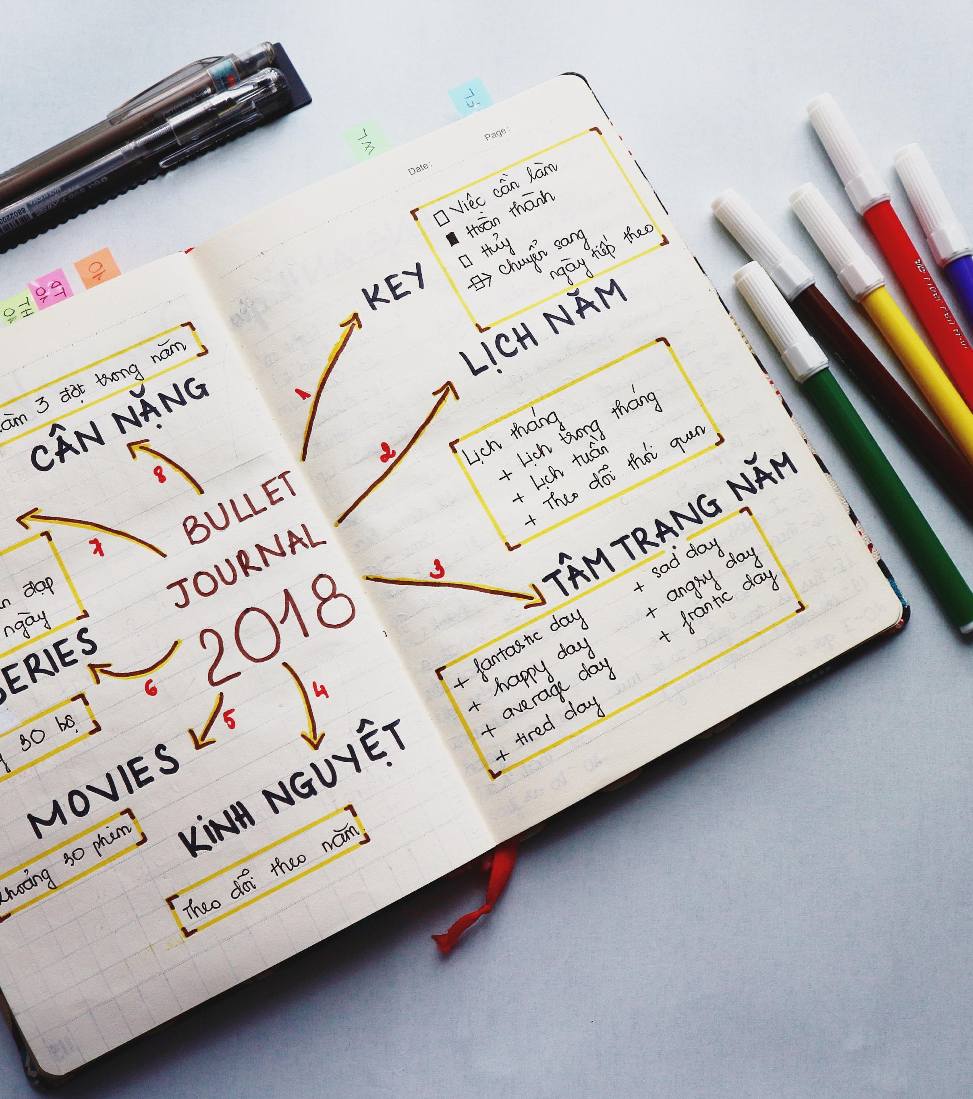
Practice the Presence
z

Slide 6
Rising Above
z

Slide 7
The Power of I AM!
You are that!!!

